Slide 1
HR ANALYTICS DASHBOARD USING POWER BI
INFORMATION VISUALIZATION

Slide 2




Team Members
Amitabh Garg (RA2211003011402) Ayush Kumar (RA2211003010256)
Priyansh Nandwana (RA221100310886) Manav Srivastava (RA2211003010864)

Slide 3
Table of Content
Introduction Problem Statement Overview Dashboard Features
Methodology Practical Applications Conclusion

Slide 4

Introduction
The HR Analytics Dashboard, developed using Microsoft Power BI, is designed to streamline HR decision-making through real-time data visualization and analysis of key workforce performance indicators. This project’s primary objective is to provide HR teams with a centralized, interactive platform that integrates multiple data sources to present insights on employee performance, retention, and engagement. By harnessing Power BI’s analytical capabilities, the dashboard offers an intuitive solution to monitor workforce metrics, enabling more efficient and data- driven HR management.

Slide 5

Problem Statement
One of the most pressing challenges in HR management is the inefficiency caused by manual data handling, which leads to difficulties in tracking employee performance in real-time. Many organizations struggle with a lack of comprehensive analytics that can support strategic decision-making in areas such as employee retention, workforce productivity, and engagement. Traditional methods often involve time-consuming processes and result in inaccuracies, preventing HR departments from effectively managing their workforce. Therefore, there is a need for a robust, automated system that consolidates and visualizes HR data in a way that allows for quick insights and more strategic planning.

Slide 6

Overview
The HR Analytics comprehensive solution
Dashboard that uses
offers a Microsoft
Power BI to create real-time, interactive data visualizations. The dashboard integrates multiple HR data sources and presents essential workforce metrics in a single, user-friendly interface. Key features include insights into employee demographics, performance, attrition rates, and engagement scores. This solution not only simplifies the tracking of employee performance and behaviour but also allows HR professionals to analyze trends and make informed decisions regarding workforce management. By automating
data visualization, organizations focus
the dashboard helps more on strategic HR
initiatives rather than manual data handling.

Slide 7

Dashboard Features
Employee demographics are visualized by department, age, gender, and tenure, allowing for comprehensive diversity analysis.
Performance metrics, such as employee
efficiency and goal achievement rates, are displayed in easily interpretable charts.
Attrition and retention through historical data,
trends with
are shown the use of
predictive analytics to help anticipate future turnover.
The dashboard includes interactive filters, enabling users to drill down into specific data points, such as department or tenure, for more tailored analysis.

Slide 8

Methodology
The development of this dashboard involved integrating various HR data sources, including internal systems such as payroll and employee surveys, with external data from SQL databases and APIs. Power BI’s data transformation tools were used to clean, normalize, and consolidate this information to ensure accurate reporting. Data modeling techniques were applied to create seamless aggregation, allowing for real-
time data structured
refreshes approach
and updates. This ensured that the HR
Analytics Dashboard provides a unified view of HR metrics, allowing organizations to make decisions based on accurate and up-to-date information.

Slide 9

Practical Applications
1.
It can improve decision-making by providing real-time insights into workforce planning, employee engagement, and performance tracking.
2.
HR managers can use the dashboard to monitor employee productivity, identify trends in attrition and retention, and adjust strategies accordingly.
3.
By automating data analytics, the dashboard reduces the administrative burden of manual reporting, allowing HR teams to focus on more strategic tasks.

Slide 10

Final DashBoard

Slide 11
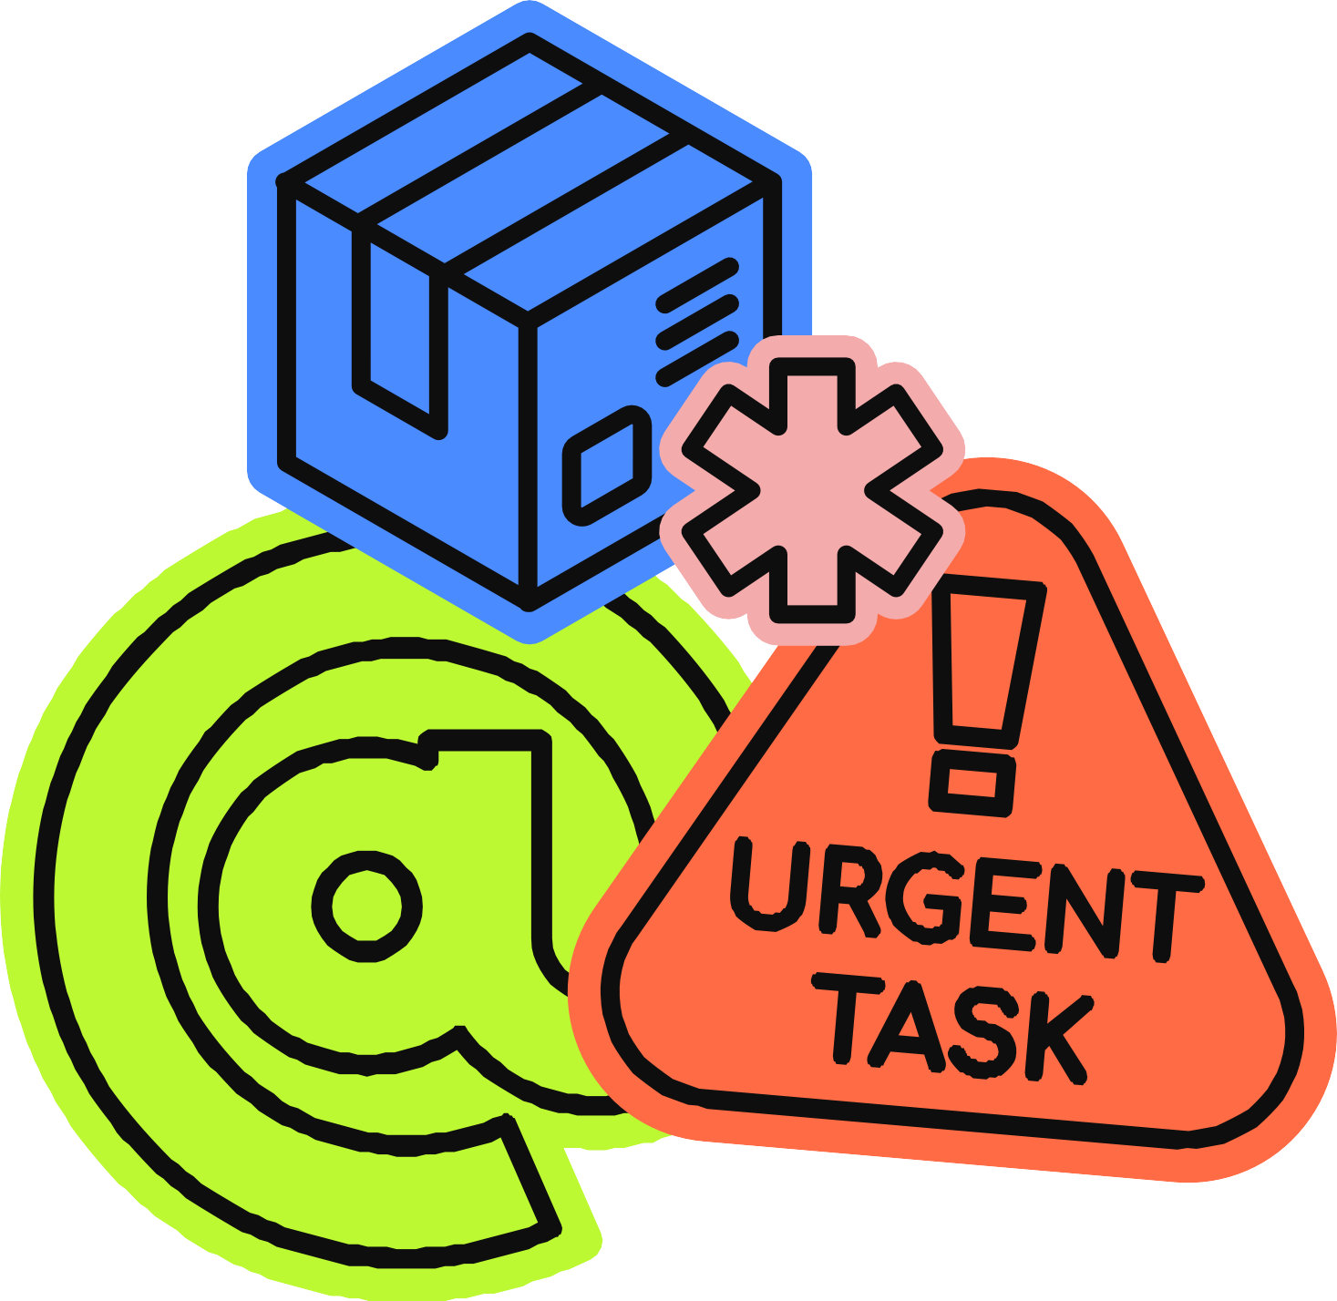
Conclusion
In conclusion, the HR Analytics Dashboard represents a powerful tool for transforming HR management through data-driven decision-making. By integrating multiple data sources into one platform, this dashboard provides HR teams with
the insights performance,
they need to optimize workforce track employee engagement, and
has
forecast future trends. Microsoft Power BI
enabled the creation of a user-friendly interface that
simplifies actionable
complex insights.
data and offers real-time, This dashboard marks a
significant step towards more efficient, predictive, and proactive HR management, paving the way for organizations to enhance their workforce strategies and improve overall organizational outcomes.

Slide 12
?
Any Questions?
Q&A

Slide 13
Thankyou!

